Slide 1
South East London: Sustainability and Transformation Plan
Briefing Paper
v6.3

Slide 2
Introduction and context
Health and care systems were asked to come together to create their own ambitious local blueprint for implementing the 5YFV, covering Oct 2016 to Mar 2021.
The STP is the “umbrella” plan for south east London
Although CCGs were developing a transformation strategy previously, the STP process has broadened this and has taken it much further by bringing organisations together to establish a place-based leadership and decision-making structure
  To date, we have established:
      A single responsible officer supported by a quartet leadership and a strategic planning board to provide direction and oversight
      Collaborative oversight and decision-making bodies at various levels
      A single reporting structure bringing transparency across the system
      A ‘single version of the truth’ setting out our challenges, including our financial challenge
    This document provides an overview of our STP
Our commitments
Over the next five years we will:
    Support people to be in control of their health and have a greater say in their own care
    Help people to live independently and know what to do when things go wrong
    Help communities to support each other
    Make sure primary care services are consistently excellent and have an increased focus on prevention
    Reduce variation in outcomes and address inequalities by raising the standards in our health services
    Develop joined up care so that people receive the support they need when they need it
    Deliver services that meet the same high quality standards whenever and wherever care is provided
    Spend our money wisely, to deliver better outcomes and avoid waste

Slide 3
STP Governance
Organisational Governance and Decision Making
STP SRO and Leadership
SRO: Amanda Pritchard, GSTT
CCG: Andrew Bland, Southwark CCG
Council: Barry Quirk, London Borough Lewisham
Clinical Lead: Andrew Parsons, Bromley CCG
Provider Meeting
Local Authority
Cabinets
Trust boards
Committee in Common
CCG Clinical Strategy Committee
CCG Governing Bodies [x6]
Collective STP Leadership
and Governance
Strategic Planning Group
Stakeholder Ref. Group
Programme
PMO
Patient and Public Advisory Group
A senior joint group for strategic decision making, led by the Senior Leadership team.
Chair: Amanda Pritchard
Members: CCG Chairs/COs (x12) Trust CEX, Local Authority rep (x1), NHSE Specialised Commissioning
In attendance: PPAG Chair
Directors of Strategy
Partnership Group
Clinical Executive Group
STP Executive Group
Finance &Technical Group
Guides design work to ensure the STP is clinically Driven
Chair(s): 1 CCG Chair + 1 secondary care lead
Members: CCG Chairs, Provider MDs, NHSE (South London) Medical Director, Public Health Lead
Chair(s): Quartet & NHSE (South London) Delivery Director
Members: CCG and provider SROs, programme director, NHSE commissioning leads, local authority representation.
Drives financial affordability and transformation
Chair(s): CCG DOF and Trust FD
Members: CCG DOFs, Trust FDs
System redesign
Productivity
Enablers
TCP
U&EC
Cancer
Planned
Chair(s): SRO productivity (Trust FD)
Members: Trust implementation leads
Estates
Workforce
IM&T
Mental Health
CBC
CYP
Maternity
Back Office
Procurement
Estates
Commissioning and payment
Mental health is also a cross cutting theme through the work of all other CLGs.
Clinical Support
CIPs
Workforce
Key:
Programme Decision Making
Programme Governance
Advisory and engagement

Slide 4
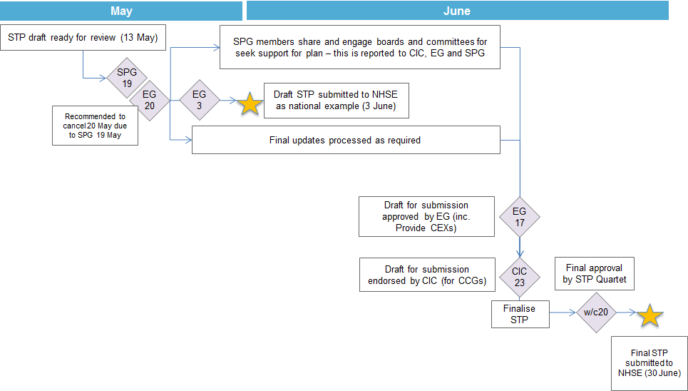
STP: Sign off process for June submission
The STP will be submitted on 30 June in advance of national discussions in July. NHSE have said that there is no need for formal board or governing body approval at this time.

Slide 5
STP: Plan on a page
Demand for health and care services is increasing.
There is unacceptable variation in care, quality and outcomes across SEL.
Our system is fragmented resulting in duplication and confusion.
The cost of delivering health and care services is increasing.
Our challenges
1
Developing consistent and high quality community based care (CBC) and prevention
2
Improve quality and reducing variation across both physical and mental health
3
Reducing cost through provider collaboration
4
Developing sustainable specialised services
5
Changing how we work together to deliver the transformation required
Promoting self-care and prevention
Improved access and co-ordination of care
Sustainability of workforce and estates
Co-operative structures across parts of the system
Financial investment by the system
Contracting and whole population budgets
Integration of mental health
Reduce pressure on and simplify A&E
Implementation of standards, policies and guidelines
Collaborate to improve quality and efficiency through centres of excellence (e.g. EOC)
Standardise care across pathways
Standardise and consolidate non-clinical support services
Optimise workforce
Capitalise on collective buying power
Consolidate clinical support services
Capitalise on collective estate
Joint commissioning and delivery models
Strategic plan for South London
London Specialised Commissioning Planning Board
Managing demand across boundaries
Mental health collaboration
Effective joint governance able to address difficult issues
Incorporation of whole commissioning spend including specialist
Sustainable workforce strategy
Collective estates strategy and management
New models of collaboration and delivery
Our five priorities and areas of focus
Reduction in A&E attends and non-elective admissions
Reduced length of stay
Reduced re-admissions
Early identification and intervention
Delivery of care in alternative settings
(Net savings c.£110m)
Cross-organisation productivity savings from joint working, consolidation and improved efficiency.
(Net saving c. £230m)
Increased collaboration
Reduced duplication
Management of flow
(Need to address £190m)
Aligned decision-making resulting in faster implementation
Increased transparency and accountability
The impact of our plans

Slide 6
STP: Summary of our priorities
1
Developing consistent and high quality community based care (CBC) and prevention | Investment in CBC is essential to transform our system and move towards lower cost, higher value care delivery. Over the next five years we will continue to support the development of LCNs to establish coherent, multi-disciplinary networks that work at scale to improve access as well as manage the health of their populations. This will include fully operational federations and networks; adopting population based budgets and risk-based contracts; and fully integrating IM&T across organisations and pathways. Fully operational LCNs will deliver our new model of care - adopting population based budgets and risk based contracts, supported by sustainable at scale delivery of primary care and enabled by fit for purpose estate and integrated IM&T across their organisations and the pathways the deliver
Improve quality and reducing variation across both physical and mental health | We have identified a range of initiatives across our system to improve consistency and standards by working collaboratively. Our main areas of focus are: reducing pressure on A&E by providing high-quality alternatives (through CBC), simplifying access and developing a truly integrated offer; collaborating to improve value within planned care pathways, including the development of centres of excellence. We are starting with orthopaedics before expanding to other specialties; integrating mental health across health and care services adopting the mind/body approach
Reducing cost through provider collaboration | Our acute and mental health providers have identified opportunities for reducing the costs of delivering care in 5 priority areas; clinical and non-clinical support services, workforce, procurement and estates. Our immediate step is developing businesses cases for each opportunity and delivering quick wins payroll, workforce and non-clinical sourcing. Over the next 5 years we will continue to look for opportunities in other areas.
Developing sustainable specialised services | We wish to develop world class and sustainable specialised services that meets the needs of patients both locally and across England. Specialised services are a significant part of SEL health economy and provide services at a local, regional and national level – a third of patients come from outside of SEL. The size of this service has an impact on the sustainability of our system both in terms of financial sustainability and the quality of other services. Specialised services offer the potential to review pathways and explore consolidation to support quality improvement and better value for money. We are supporting NHSE to establish a London-wide board.
Changing how we work together to deliver the transformation required | To deliver this plan we must establish the right governance, secure appropriate resources and address system incentives. This transformation will mean having to think differently and more radically. Crucially our structures must allow us to make difficult decisions and investment in transformation for the benefit of the system rather than our own organisations. Our immediate priority is developing the appropriate infrastructure to deliver our plan, agreeing roles and functions across the system. We are learning from our acute care collaboration vanguard between Guy’s and St Thomas’ and Dartford and Gravesham.
2
3
4
5

Slide 7
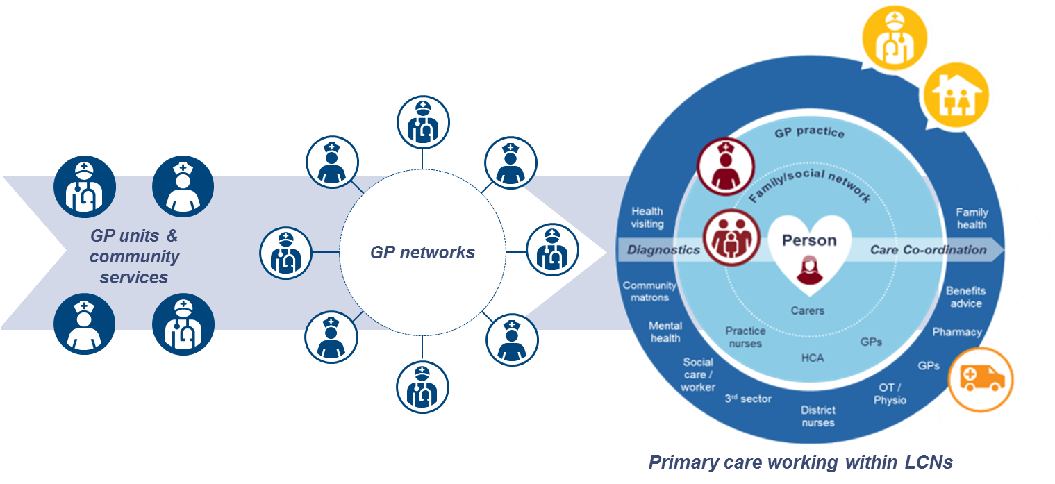
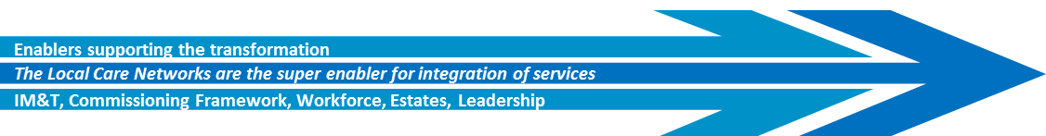
1. Investment in CBC is essential to transform our system and move towards lower cost, higher value care delivery
Primary and community care (defined in its broadest sense) will be provided at scale by Local Care Networks and drawing on others from across the health, social care and voluntary sector to provide:
Accessible care
Proactive care
Coordinated care
Continuity of care

Slide 8
2. We have identified a range of initiatives across our system to improve consistency and standards by working collaboratively
Clinical Leadership Group | High level summary of the model of care | Estimated savings
Community based care | Delivery of local care networks | £48m
Urgent and emergency care | Improving access in Primary Care, in hours and out of hours, to unscheduled care. Specialist advice and referral. An enhanced single “front door” to the Emergency Department. | £71m
Planned care | Standardisation of planned care pathways. Enhanced diagnostics. Elective care centres. | £41m
Children and young people’s care | Children’s integrated community teams. Short stay paediatric assessment units. | £13m
Maternity | Early assessment by the most appropriate midwife team. Access to assessment clinics. Culture of birthing units. | £6m
Cancer | Primary prevention including early detection. Provider collaboration in treatment of cancer. Enhanced end of life care. | £10m
 | Net savings after 40% reinvestment £113m | Gross Total £189m

Slide 9
Integrating mental health is a key area of focus across our priorities
Community based care | Integrated mental and physical health in CBC by aligning services, developing multi-professional working, supporting people with housing and meaningful occupation including employment and increase training of teams within LCNs Building mental health into our approach for capitated budgets and risk sharing Incorporating mental health into our population health management approach Increase early access in primary care Tackling wider determinants of health in children and their families Improved services for people with dementia
Improving quality and reducing variation across both physical and mental health | Embed an integrated mind/body approach to support both the physical and mental health of patients and service users Deliver quality improvement methodologies across the provider landscape Improving timely access to specialist mental health support in the community Increase diagnosis rates for people with mental health conditions Develop access to crisis care for children and adults Explore how we can achieve the four hour target for mental health and ceasing OATs Ensure sufficient and appropriate capacity is available to meet future demand
Improving productivity through provider collaboration | In addition to the collaborative productivity work across all SEL providers we are: Establishing a pan-London procurement approach for mental health providers, and a shared approach to procurement of legal support across south London Implementing A joint approach across providers in south London to managing the budget for forensic provision and which could potentially be extended to specialised commissioning of mental health services for children and young people Collaborative approaches to estates planning to support new models of care and more integrated working
Optimising specialised services | We are trialling a new way to manage budgets for specialised services through our collaboration between the three south London mental health trusts to take on the specialised commissioning budget for adult secure services. We will assess how this approach could be extended to other areas
Standardised care across pathways | Ensure a standardised approach to Making Every Contact Count Encourage open and positive discussion about mental health and wellbeing across settings. Promote excellence in relation to mental health across all services and conditions Increase early identification and early intervention, including the use of screening for mental health needs

Slide 10
3. Our acute and mental health providers have identified opportunities for reducing the costs of delivering care in 5 priority areas
Standardise and consolidate business support services
Capitalise on the collective estate
£28m
£41m
Optimise the workforce
Ease of implementation
£64m
£41m
£73m
Capitalise on our collective buying power
Consolidate clinical support services

Slide 11
4. We wish to develop world class and sustainable specialised services that meets the needs of patients both locally and across England
We have been working collaboratively with NHSE to develop the specialised content for the STP. We now have a greater understanding of the challenge, the future programme of work and the need to work with colleagues in South London to ensure sustainable and high-quality services.
Involvement to date in developing the STP | An indicative high-level estimate (in a ‘do-nothing’ scenario) on the projected specialised commissioning funding gap for the April STP submissions (based on a top-down approach). Updated modelling outputs will be ready for inclusion in the June A portfolio of transformation projects, as part of the Healthy London Partnership, is being developed to improve quality, consistency and efficiencies in specialised services. Initial London projects are focusing on: neuro-rehabilitation; CAMHS Tier 4; HIV services and paediatric and neonatal transport
Development of a London-wide programme board | Given the scale and challenge of specialised commissioning there needs to be a specific London-wide focus on specialised services A new regional Specialised Commissioning Planning Board is being set up to include all five STP ‘system leaders’, representatives of specialised providers and national and neighbouring regional specialised commissioners to set strategic direction and priorities
Sustainable services across South London | There are potential opportunities for reviewing current service provision across South London and discussions have started between NHSE, and SEL & SWL STP leads

Slide 12
5. To deliver this plan we must establish the right governance, secure appropriate resources and address system incentives
  Balancing system benefit and impact on individual organisations to make decisions that are in the best interest of patients and sustainability of the system
  Aligning transformation funding to the objectives of the STP by building processes to ensure that investment across the system supports our collective vision
  Investing in shared planning and delivery to ensure that a collaborative approach runs throughout the programme with the appropriate resources
  Align system incentives that drive population health and value and shared risk.
  Have an ongoing dialogue with our stakeholders through existing and new communication channels
  A system-wide delivery plan and agreed measures to monitor the implementation of the STP
  Working collaboratively across London with existing partners including HLP
  Adopting new models of collaboration and delivery by collaborating and learning lessons from local and national vanguards

